Slide 1
TOEIC 250
LESSON 6

Slide 2
WHAT DO WE LEARN TODAY?
Vocabulary
LISTENING
COMPUTERS
PHOTO DESCRIPTION

Slide 3
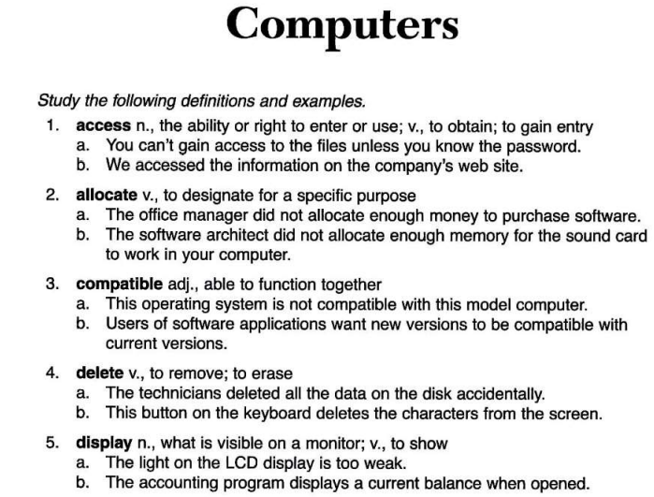

Slide 4
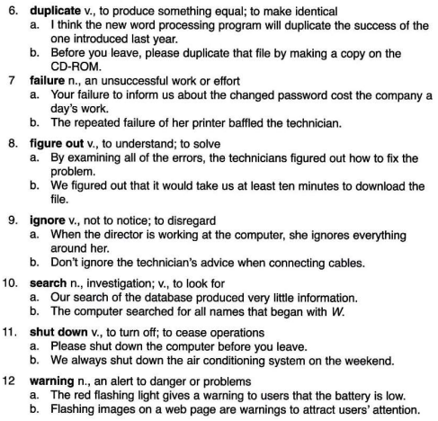

Slide 5
VOCABULARY PRACTICE

Slide 6
quizlet
https://quizlet.com/_93gkay?x=1jqt&i=3bqzmg
Password: 123adg#

Slide 7
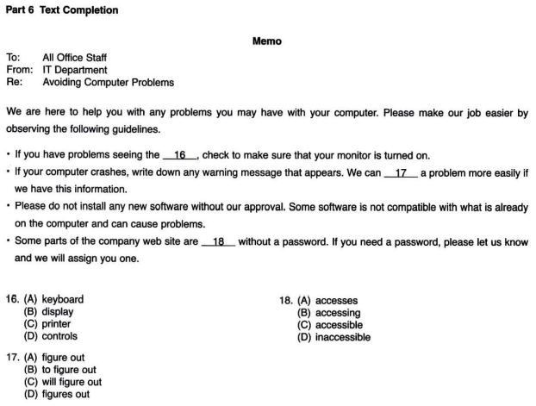
16.B
17.A
18.D

Slide 8


Slide 9

affordable /əˈfɔːdəbl/ adj., able to be paid for; not too expensive
không quá đắt, phải chăng, có thể chi trả
The company's first priority was to find an affordable phone system.
Obviously, the computer systems that are affordable for a Fortune 500 company will not be affordable for a small company.
Word family:
Afford: (v)
affordability (n)
Affordably (adv.)

Slide 10
2. as needed adv., as necessary : Khi cần thiết
a The courier service did not come every day, only only as needed.
b. The service contract states that repairs will be made on an as-needed basis.
Word family
Need (v) to V/ V-ing: need Ving: My bike needs repairing
Needy = poor : a needy family
Need (n)
Idiom
A friend in need is a friend indeed

Slide 11
3. be in charge of v., to be in control or command of
Chịu trách nhiệm về…, phụ trách cái gì ….
He appointed someone to be in charge of maintaining a supply of paper in the fax machine.
Your computer should not be in charge of you, rather you should be in a. charge of your computer.
Note:
be in charge of = be responsible for

Slide 12
4. capacity /kəˈpæsəti/ n., the ability to contain or hold; the maximum that something can hold or do or do
Dung lượng, công suất, sức chứa
The new conference room is much larger and has a capacity of one hundred people.
b. The memory requirements of this software application exceed the capacity of our computers

Slide 13
5. durable /ˈdjʊərəbl/ adj., sturdy, strong, lasting: bền
This printer is so durable that, with a little care, it will last another five
b. These chairs are more durable than the first ones we looked at
duration
Word family
Durability: = durableness (n)
durably (adv)
Durable = long-lasting

Slide 14
6. initiative /ɪˈnɪʃətɪv/ n., the first step: an active role a years. : sáng kiến
Employees are encouraged to take the initiative and share their ideas with management.
Our technology initiative involves an exciting new database system and will help us revolutionize our customer service.
Note:
Initiation: sự khởi đầu
Initial: chữ cái đầu

Slide 15
7. Physically /ˈfɪzɪkəli/ adv., with the senses; of the body: về mặt thể chất, vật chất, vật lý, thân thể
The computer screen is making her physically sick.
Physically moving your screen from one place on the desk to another can help reduce same-position-strain syndrome.
Physical (adj)

Slide 16
8. Provider /prəˈvaɪdə(r)/ n., a supplier nhà cung cấp
a. The department was extremely pleased with the service they received from the phone provider.
b. As your health service provider, we want to make sure you are happy and satisfied with the service you are receiving.
note
Provide (v) – supply
Provision (n)

Slide 17
9. recur/rɪˈkɜː(r)/v., to occur again or repeatedly : lặp lại
The subject of decreasing sales recurs in each meeting, sometimes several times.
b. The managers did not want that particular error to recur.
Note:
Recurrence (n)
a recurrent (adj.)
Sym: repeat/ return

Slide 18
10. reduction /rɪˈdʌkʃn/ n., a lessening; a decrease : giảm
a. The outlet store gave a 20 percent reduction in the price of the shelves and bookcases.
b. The reduction in office staff has made it necessary to automate more job functions.
Reduce (v)
Sym.
Decrease/ drop/ fall/ decline/ lessening
Discount/ bargain/ cut/ saving

Slide 19
11. stay on top of v., to know what is going on; to know the latest information : hiểu được, nắm được,… catch up with
a In order to stay on top of her employees' progress, she arranged weekly breakfast meetings. (=appointment)
b. In this industry, you must stay on top of current developments.

Slide 20
12. Stock /stɒk/ v., to keep on hand; n., a supply
Joint stock company
Stockholder= shareholder
Cung cấp hàng hóa , tích trữ (v) kho hàng (n)
The employees stocked the shelves on a weekly basis.
b. The office's stock of toner for the fax machine was quickly running out.

Slide 21
Part 6 Text Completion
MEMO
To: Miriam Ketonen, Office Manager
From: Jason Roberts, Assistant Office Manager
Re: Photocopier
There have been recurring problems with the office photocopier, particularly with paper jams. I believe the problem is with the type of machine we have. A machine of this size simply does not have the capacity to handle the amount of copying we normally do. Obviously we can't (16) _________________ the number of copies we make. I suggest that it's time to order a larger and (17) ____________ machine. I have looked through the catalogs and discovered several that I think would suit our needs. I have selected the most (18) ____________ ones, as I know we have a limited amount of money to spend. I have attached their descriptions. Since you are in charge of making large purchases like this, I will need your approval before I go ahead and place the order. Let me know which of the machines you think is best, and I will fill out the purchase order.
Thanks.
16. (A) reduce (B) reducing (C) reducible (D) reduction
17. (A) durable (B) durables (C) more durable (D) most durable
18. (A) costly (B) physical (C) attractive (D) affordable

Slide 22

Part 1: picture description

Slide 23
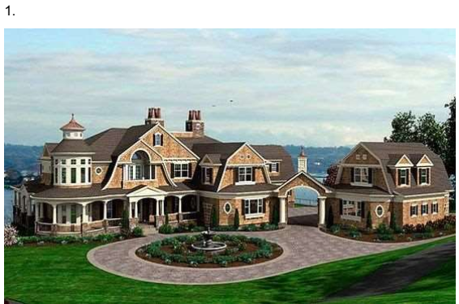
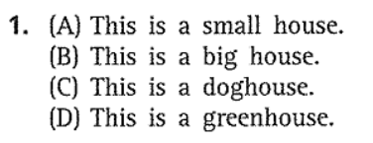
Directions: For each question in this part, you will hear four statements about a picture in your test book. When you hear the statements, you must select the one statement that best describes what you see in the picture

Slide 24
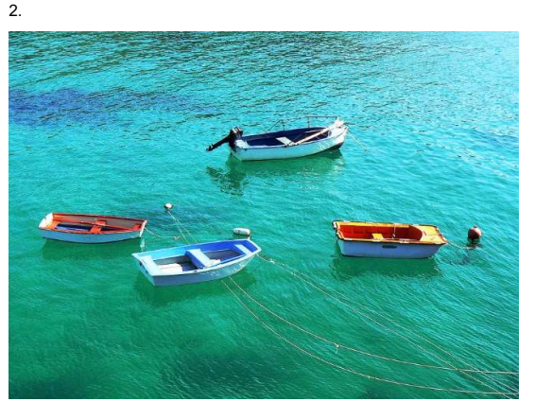
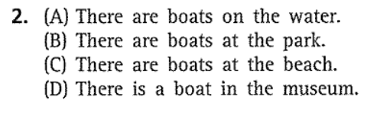

Slide 25
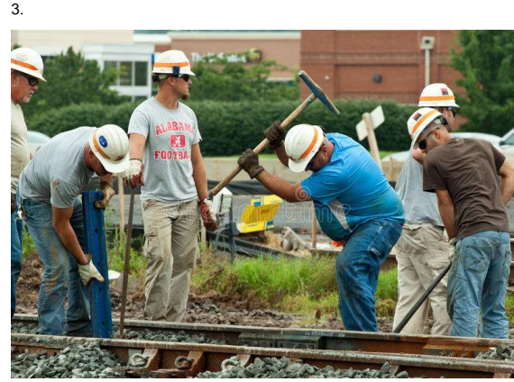
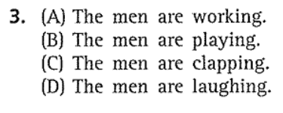

Slide 26

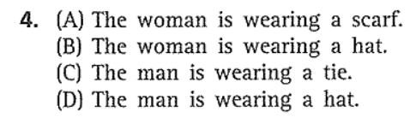

Slide 27
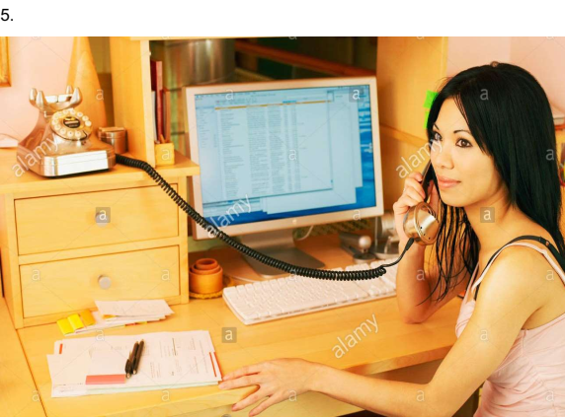
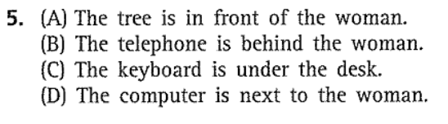

Slide 28
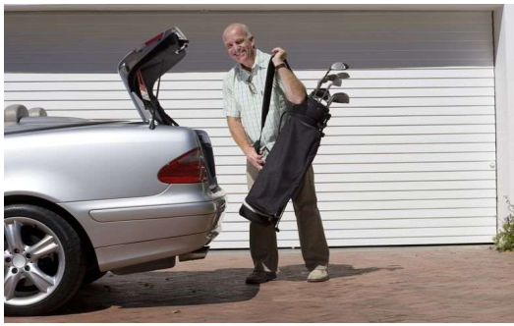
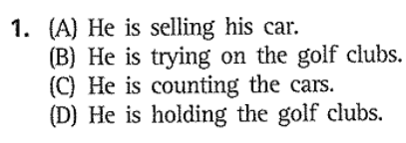

Slide 29
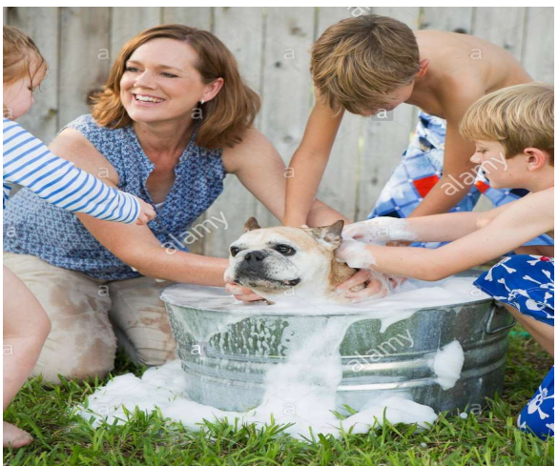
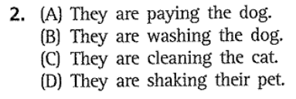

Slide 30
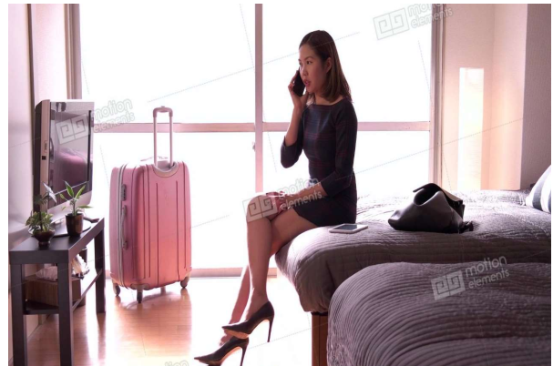
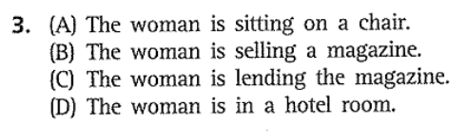

Slide 31
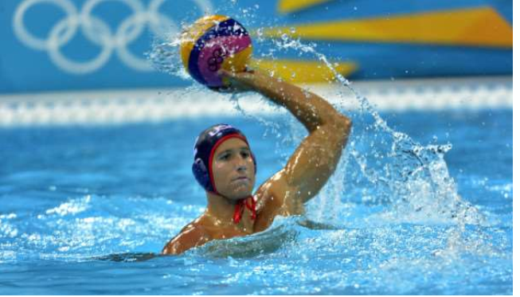
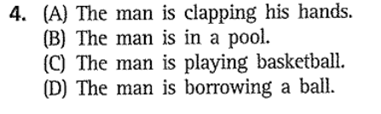

Slide 32
